Slide 1
Study of Japanese Immigration in Southern California

Slide 2
Japanese-American Community and Torrance
Largest Japanese-American community in SoCal
People started to move in 1982 when Toyota set its center of operation at Torrance
Where would be a good alternative cities to live for new immigrant from Japan?

Slide 3
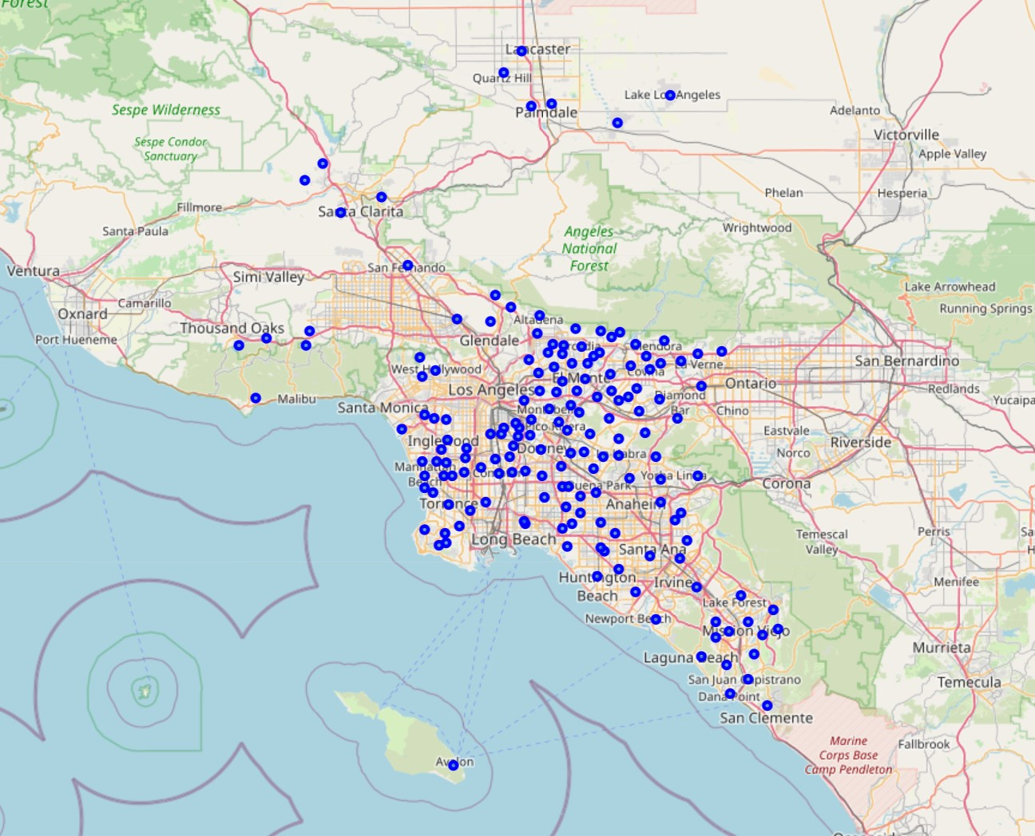
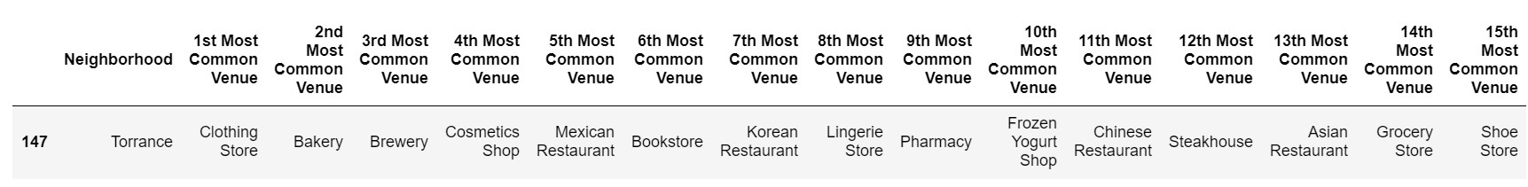
Study Area
Foursquare API was used to explore the cities listed on the map
Common venues in each cities were listed in highest order
Table below is example from Torrance

Slide 4
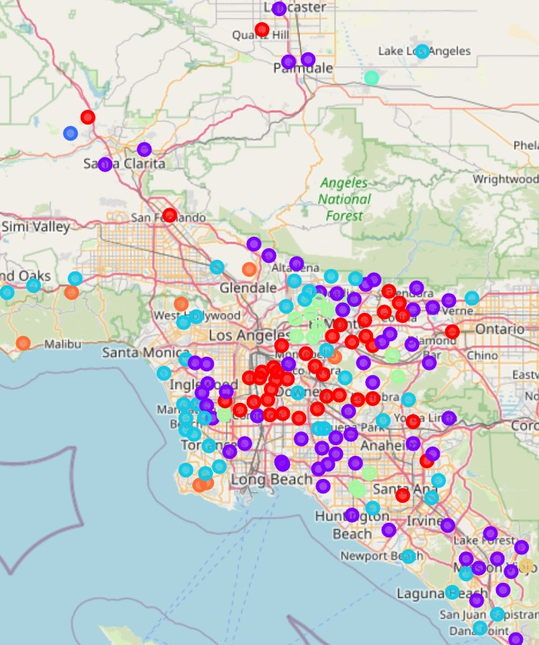
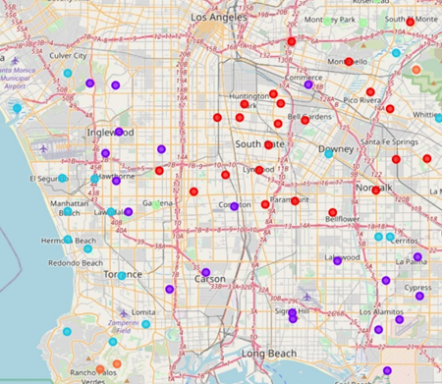
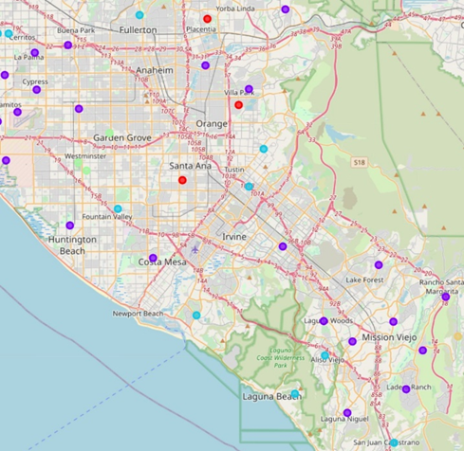
K-Mean Clustering
Torrance felt into cluster group 3 (light blue dots)
Zoom-in for Los Angeles Zoom-in for Orange County

Slide 5
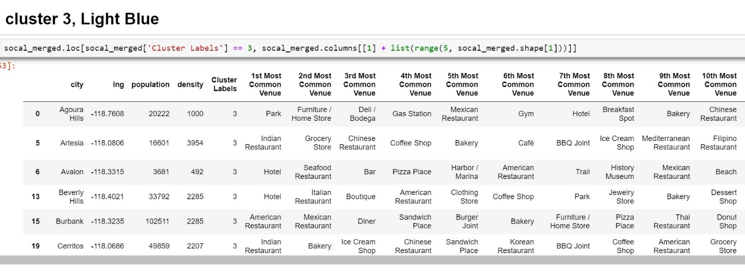
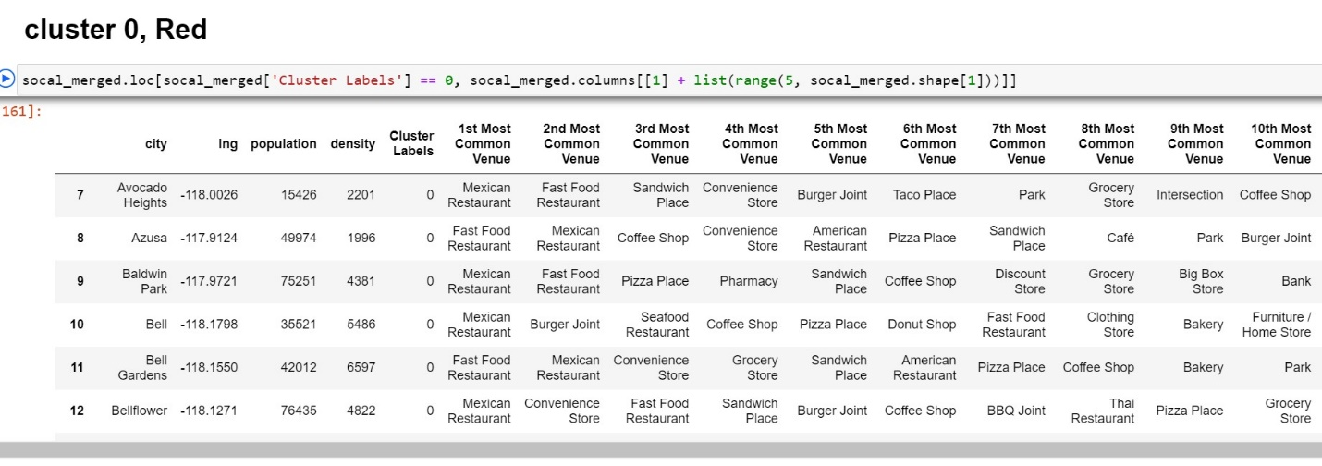
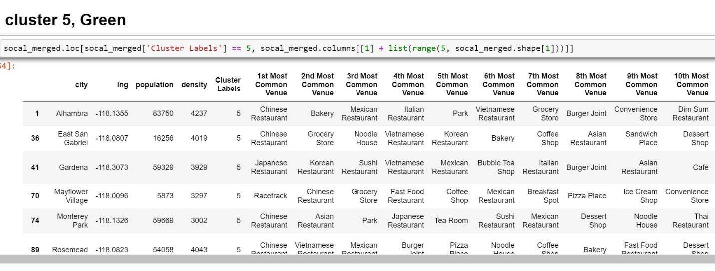
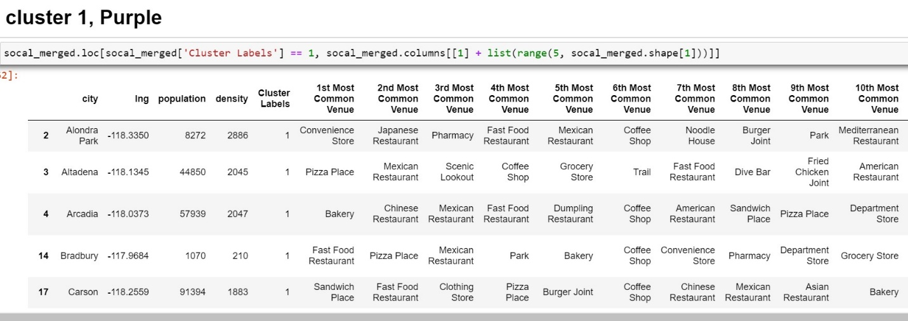
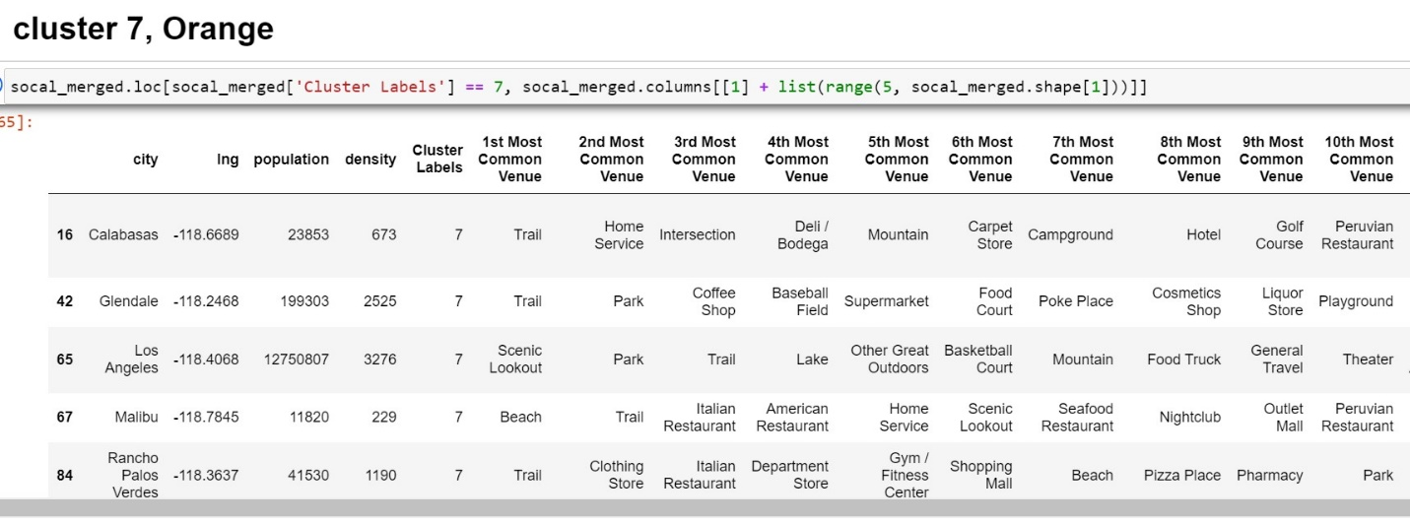
Result from Each Cluster

Slide 6
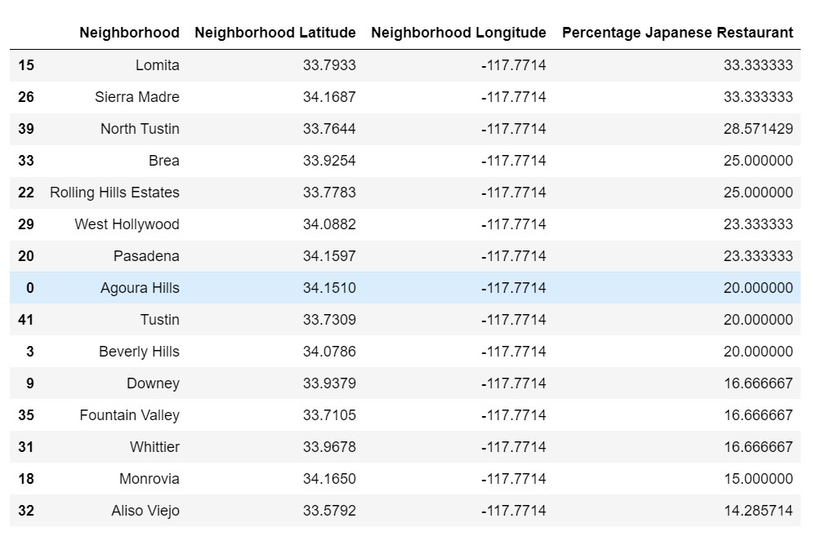
Top 15 Cities from Cluster 3 with more Japanese Restaurants

